Slide 1
Poll
Have you connected with your state director concerning CTE?
Have you connected with or coordinated with any locat CTE directors or programs?
Select all that apply:
Does your state network or organization do work directly or work with programs which:
Help introduce students to different types of careers
Teach or develop skills such as communication, leadership, creativity, collaboration, punctuality, or problem solving
Work in coordination with local businesses
Work to build student interest in areas where those students are not traditionally represented (ie girls in STEM, boys in nursing)
Work with special populations of students including low income students, special education students, English language learners

Slide 2
Afterschool Programs –
Important partners in CTE Planning and Implementation
February 26, 2019

Slide 3
Housekeeping Notes
Experiencing Delays?
Try closing out the other programs running on your computer.
Have a question or comment?
Use the group chat to interact with presenters and other participants.
Notes:
ep

Slide 4
Agenda
Introduction
Jillian Luchner, Policy Manager, Afterschool Alliance
CTE Legislation
Austin Estes, Senior Policy Associate, Advance CTE
State Network Action
Zelda Q. Waymer, Executive Director, South Carolina Afterschool Alliance
Susan Stanton, Network Lead, ACT Now Coalition (IL)
Jeff Cole, Network Lead, Beyond School Bells (NE)
Tools to Help
Chris Neitzey, Director of STEM Initiatives, Afterschool Alliance
Q&A
You may type questions in the chat box at any time

Slide 5
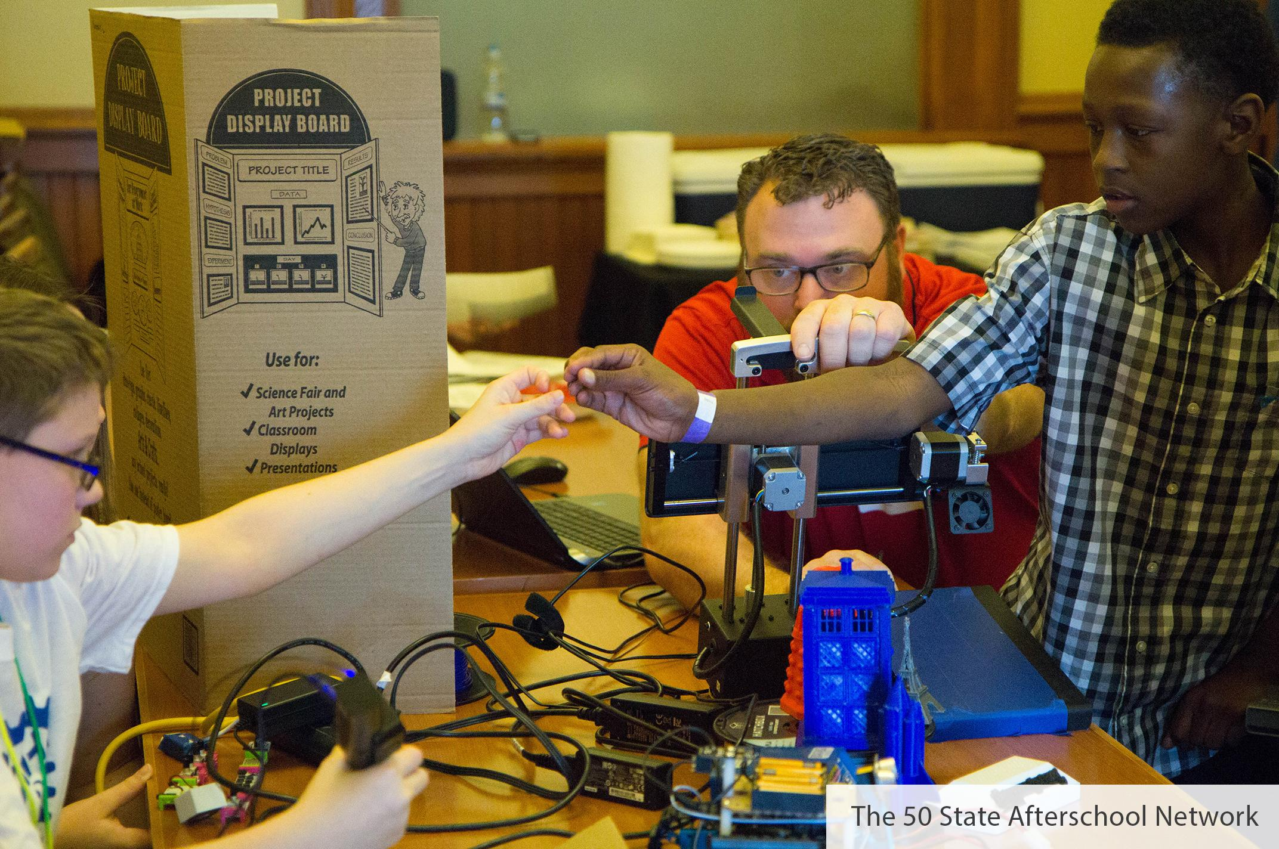
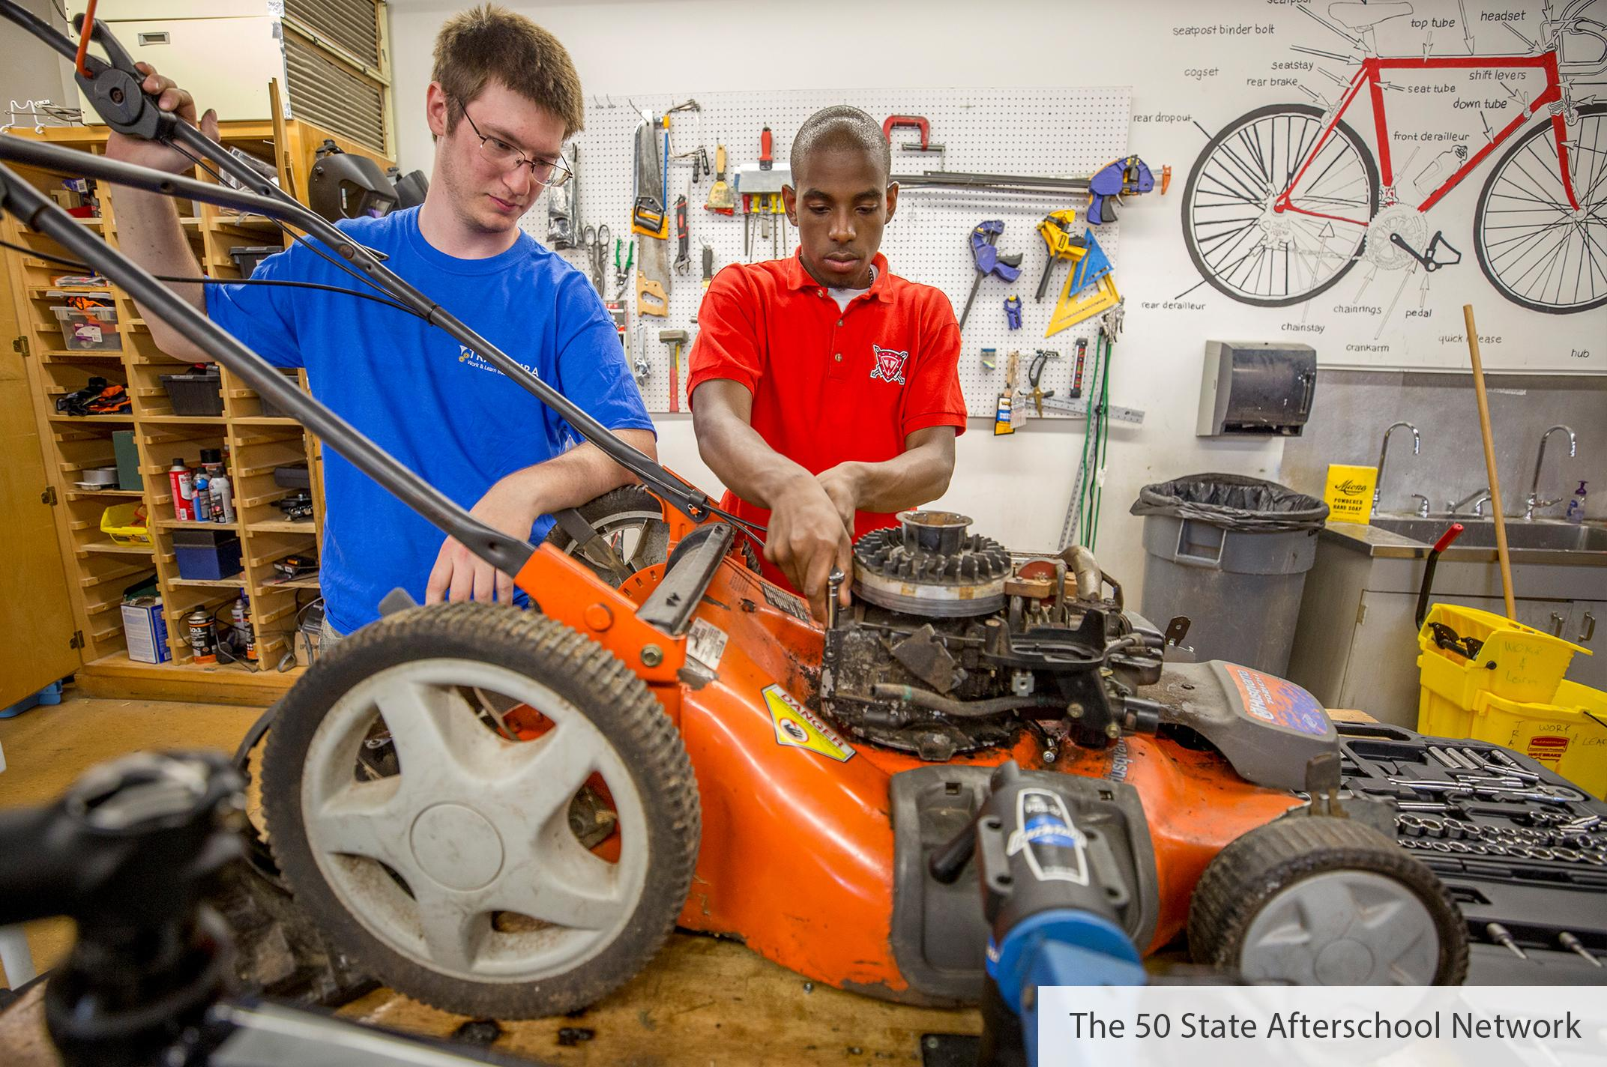
Coordination and the Law
21st Century Community Learning Centers
(Title IV B of the Every Student Succeeds Act of 2105)
Strengthening Career and Technical Education for the 21st Century Act (Perkins V) 2018
NEW LANGUAGE on local activity fund uses: “programs that partner with the in-demand fields of the local workforce or build career competencies and career readiness and ensure tha local workforce and career readiness skills are aligned with the Carl D. Perkins Career and Technical Education Act and the Workforce Innovation and Opportunity Act.”
(Sec. 4205, a, 14)
NEW LANGUAGE on eligible uses of local funds: “Sustainable relationships among education business, and industry and other community stakeholders..designed to facilitate the process of continuously updating and aligning programs of study with the skills that are in demand...and in collaboration with...other appropriate organizations including community based and youth-serving organizations” (Sec. 135, 5, B)
Notes:
The message is clear – when laws work together, students get improved service. And while statewide afterschool networks and local afterschool programs have often worked with career tech ed because of the natural connections the law also opened and expanded areas in which afterschool programs and CTE can work together

Slide 6
Perkins CTE and Afterschool
Employability Skills
Career Exposure
Middle Grades
Non-traditional Fields
Intermediaries
Innovation
Notes:
The New Perkins V Law includes important updates for afterschool including:
Employability Skills: The law mentions the importance of employability skills in career development (like collaboration, communication, and problem solving).
Middle School Career Exposure: The law expands eligible uses to allow for career exposure, exploration and preparation, and it permits use of funds as early as the middle grades (fifth grade through eighth grade).
State Planning: As in the past, the law requires inclusion of interested community-based partners in the state planning process.
Working with Intermediaries: The law mentions partnerships with community-based partners within the definition of qualified intermediaries (non-profits that connect students with opportunities).
Eligible Uses of Local Funds: The law for the first time explicitly lists partnerships with community-based and youth-serving organizations as eligible uses of local funds.

Slide 7
Understanding Perkins V
Austin Estes, Senior Policy Associate
Advance CTE
February 26, 2019

Slide 8
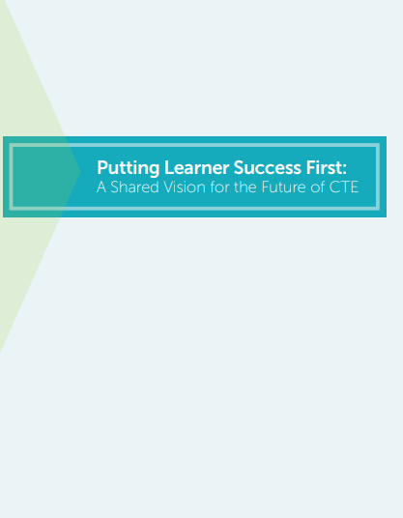
Setting a Vision for Career Readiness
All CTE programs are held to the highest standards of excellence.
All learners are empowered to choose a meaningful education and career.
All learning is personalized and flexible.
All learning is facilitated by knowledgeable experts.
All systems work together to put learner success first.

Slide 9
Perkins is a lever – one of many – that can be used to achieve your state’s vision for career readiness

Slide 10
What is the Perkins Act?
Invests more than $1.2 billion a year in secondary, postsecondary and adult Career Technical Education (CTE) programs
Dedicated to the continuous improvement of CTE and expanding learner access to high-quality CTE programs of study
Perkins is administered by a state-designated eligible agency. Local recipients submit a local application to receive Perkins funds.

Slide 11
CTE in the U.S.

Slide 12
Perkins V

Slide 13
Perkins V
The Perkins Act was reauthorized on July 31, 2018 as the Strengthening Career and Technical Education for the 21st Century Act (Perkins V)
Perkins V reauthorizes the federal CTE law until 2024
The Act was reauthorized unanimously with widespread bipartisan support

Slide 14
State Plan Development & Submission Process

Slide 15
Major Tenets of Perkins V
Program Improvement
Comprehensive local needs assessment
New national competitive grant program
Focus on labor market alignment
Flexibility
Retains governance structure
Expands support to middle grades
Alignment to ESSA and WIOA
Data & Accountability
State-determined performance levels
Focus on equity
Shifts in accountability indicators

Slide 16
Perkins V Key Opportunities
Get involved in developing your state’s Perkins V plan
Stakeholder engagement
Setting a state vision for career readiness
Development of the local needs assessment
Engage local leaders
Align afterschool curriculum with CTE programs of study
Serve as an intermediary between employers and students
Support the local needs assessment

Slide 17
Join the Campaign to Double the Investment in CTE
Got to isupportcte.org to learn more and sign on today!

Slide 18
Learn More
Perkins info and resources: https://careertech.org/Perkins
Putting Learner Success First: https://careertech.org/vision
Learning that Works Resource Center: https://careertech.org/resource-center

Slide 19
Questions?
Austin Estes
Senior Policy Associate, Advance CTE
aestes@careertech.org
Follow us @CTEWorks .
www.careertech.org

Slide 20
Zelda Quiller Waymer
Executive Director, South Carolina Afterschool Alliance

Slide 21
Profile of the South Carolina Graduate

Slide 22
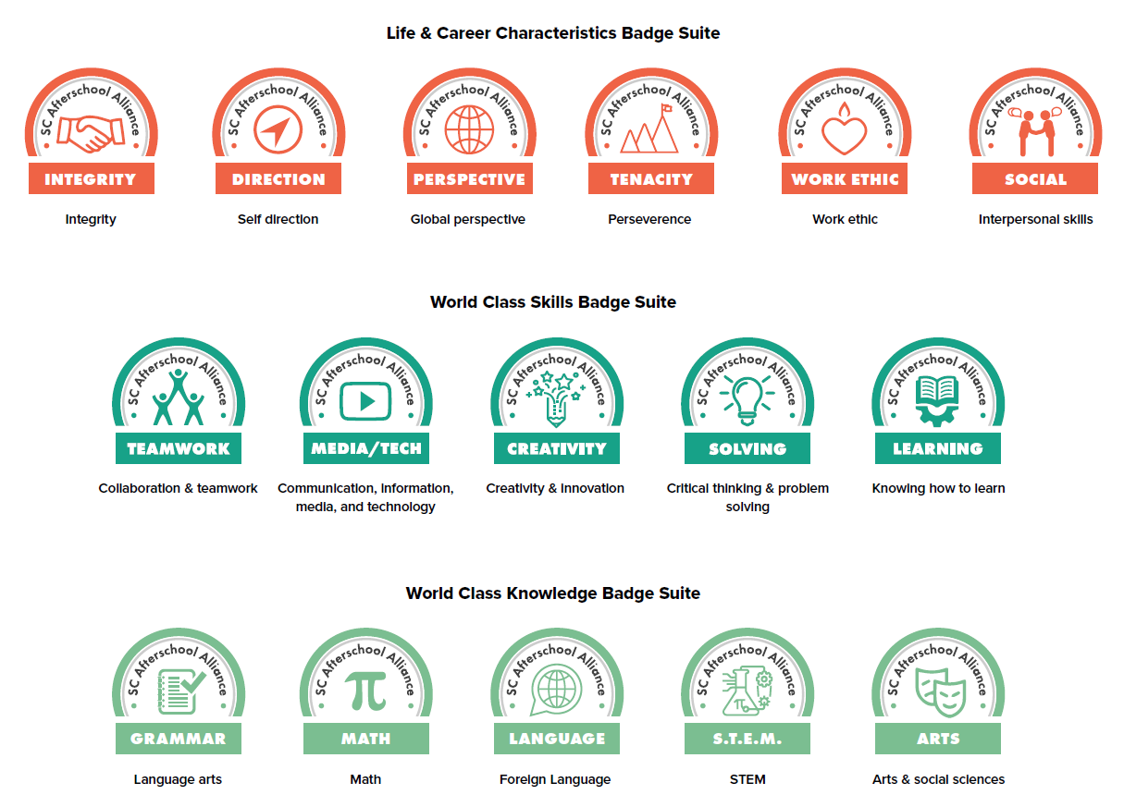
Suite of Digital Badges

Slide 23
Claflin University Biomedical/Biomaterial Research Summer Internship

Slide 24
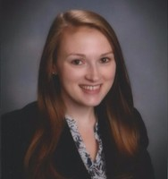
ACT Now Perkins CTE Work
Illinois Statewide Afterschool Network
Susan Stanton, Network Lead

Slide 25
Timeline/Overview
Engaging More in STEM/ Workforce Development (Summer/Fall 2018)
Perkins Listening Tour (Dec. 2018)
STEM Guiding Team Discusses Workforce Policy (Jan. & Feb. 2019)
STEM External Stakeholders Meeting (Feb. 2019)

Slide 26
Increase STEM/Workforce Engagement
Why
Building support for afterschool
An area of need for the field
STEM Survey
STEM Guidebook
STEM Panel
STEM Guiding Team

Slide 27
Perkins Listening Tour
Held throughout the state and a webinar
Provided an overview of Perkins and asked for feedback
Group discussion
Focused on vision
Statewide activities
Best practices/challenges in the field
Survey of attendees
Submitted letter with comments: http://www.actnowillinois.org/wp-content/uploads/2019/02/Listening-Tour-to-Inform-Five-Year-Plan-on-Career-Connected-Learning-1.pdf

Slide 28
STEM Guiding Team
A group of STEM OST leaders coming together to develop a statewide strategy to expand STEM OST opportunities
I.e. museums, industry partners, agency partners, advocates, providers, etc…
Focusing on
STEM messaging
Workforce/STEM policy advocacy
Increasing STEM professional development opportunities
Increase awareness about workforce preparedness initiatives at the state and local level
Notes:
Had to really start from the beginning
A lot of excitement in building partnerships for the field

Slide 29
External Stakeholders Planning Group
All day meeting and three additional virtual meetings with assigned workgroup
Workgroup topics:
Equity and access
Transitions and alignment
Data and accountability
Employer engagement
Teacher pipeline
Innovation
Participated in the equity group
Notes:
Overall a lot of concerns with the teacher pipleline and modernizing the way we think about and run CTE
Had to reminder people about starting young a lot
Equity group was very post secondary focused
Talked a lot about logistical issues in getting to postsecondary (we are more flexible in grad programs)
Surprise with share decisionmaking
Suggested going to where these kids we are targeting area-- OST

Slide 30
Illinois Planning Timeline
Fall 2018- Spring 2019
State engages stakeholders
Spring- Summer 2019
Local recipients engage stakeholders
Summer 2019
State posts state performance targets for 60 days
Fall 2019
Draft plan posted for 30 days
Local needs assessment
Winter 2019/2020
State revises plan
Spring 2020
Governor/board approval
April submit plan

Slide 31
Contact Information
Stantons@actnowillinois.org
Resources: www.actnowillinois.org

Slide 32
Jeff Cole
Network Lead, Beyond School Bells, Nebraska

Slide 33
Afterschool Career Curriculum Guides
Notes:
https://beyondschoolbells.org/resources/bsb-curriculum.html
https://beyondschoolbells.org/videos/career.html

Slide 35
Chris Neitzey
Director of STEM Initiatives, Afterschool Alliance

Slide 36
Engaging your State CTE Director as a Statewide Afterschool Network

Slide 37
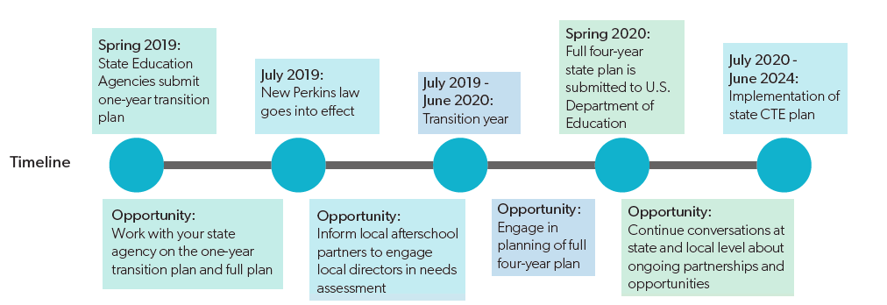
Toolkit for Engagement – Coming Soon

Slide 38
A 1-2-3 Toolkit for CTE Engagement
Reach out to your state CTE director
Reach out to your CTE Director to be part of the plan (Careertech.org/state-director-list)
Sample Letter - Phone Call - Find a connection
Tell them what you do and how afterschool supports students academic and career success
Use the language of the law where you can
Employability skills
Career exposure
Intermediaries between school, business, parents, partners and the community
Non-traditional field exposure
“Afterschool programs help schools develop the employability skills that employers are looking for in new hires, including critical thinking, communication, problem solving, and teamwork and collaboration.”
Need talking points – reach out to us!

Slide 39
A 1-2-3 Toolkit for CTE Engagement
2. Identify how your state is using the state leadership activity funds
Discuss possible curriculum support
Discuss summer programs
Discuss other innovative methods of programming
Identify how your state uses funds

Slide 40
A 1-2-3 Toolkit for CTE Engagement
Plan a local strategy
3. Plan a local strategy
Inform the field about the local needs assessment process
Help them to understand how to reach out locally by sharing the language and talking points around the law
Have them talk to their local director about the eligibility of youth serving organizations in the local uses of funds
Ensure they continue to share their storied and build relationships that help students find pathways to success in college, career and life
Full Toolkit Coming in Late March…

Slide 42
Q&A
Questions and discussion
Type your comments in the chat box or unmute your device

Slide 43
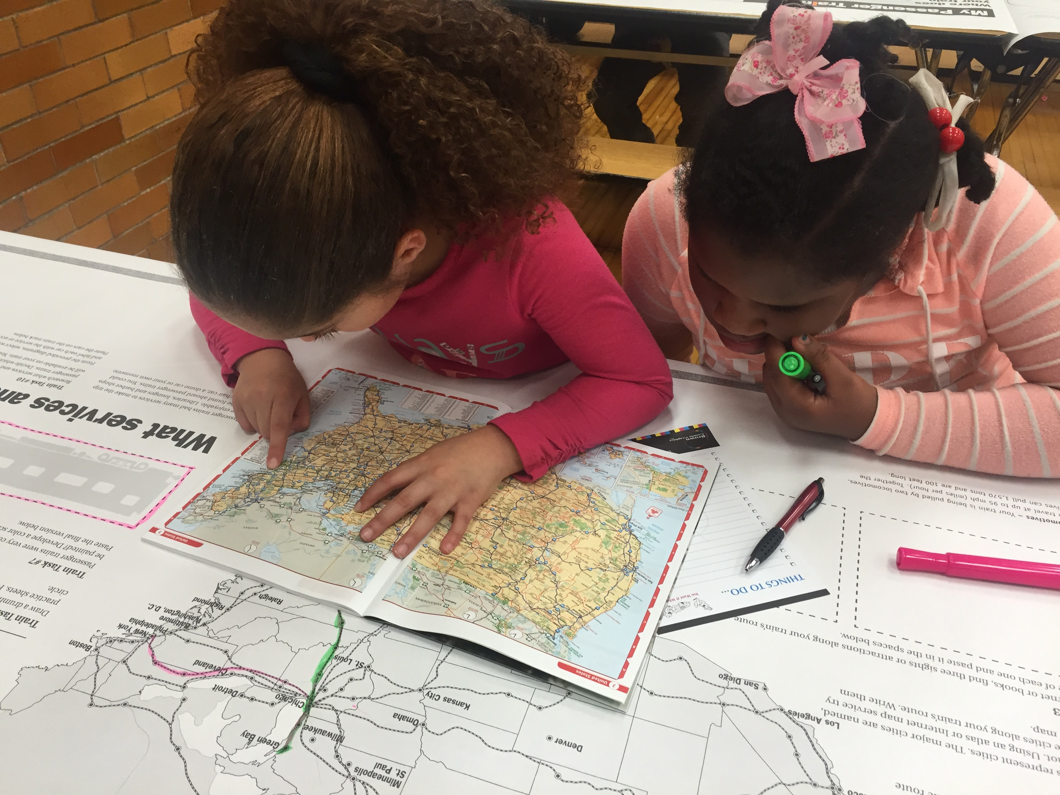
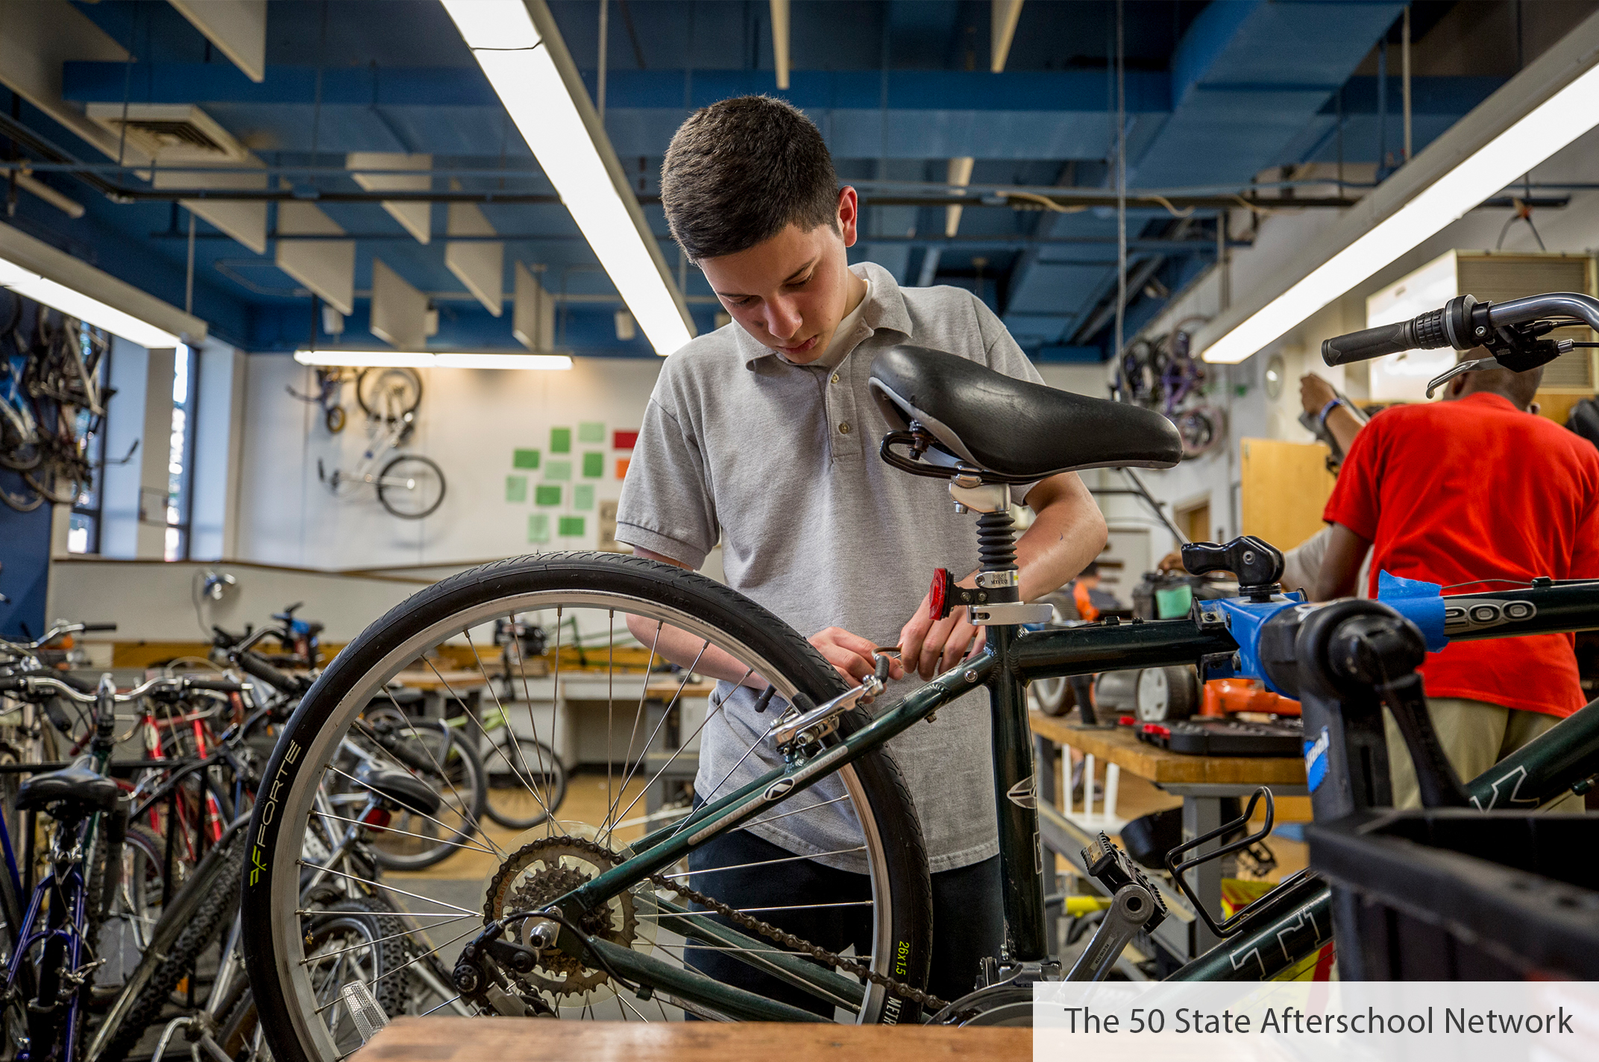
Thank you!

Slide 44
Youth Serving Organizations Play a Role in CTE
State Planning
Local Planning and Needs Assessments
Eligible uses of Local Funds
Community Based and Youth Serving Providers
Notes:
To emphasize the importnace of partnerships the law discusses the involvement of community based and or youth serving partners in involvement at the state leval in planning at the local level with planning and the new needs assessment processes and at the level of using local funds for eligible collaboration with youth serving organizations

