Slide 1
The Every Students Succeeds Act:
What does it mean for afterschool and summer learning?
Thank you for joining us. The webinar will begin shortly.

Slide 2
Housekeeping Notes
Experiencing Delays?
Try closing out the other programs running on your computer.
Audio difficulties? Keep this number handy!
Dial: 1-877-860-3058
Code: 1135574
Have a question or comment?
Use the group chat to interact with presenters and other participants.

Slide 3
Speakers
Erik Peterson
VP of Policy
Afterschool Alliance
Ellen Fern
Managing Director
Washington Partners
Anita Krishnamurthi
VP of STEM Policy
Afterschool Alliance

Slide 4
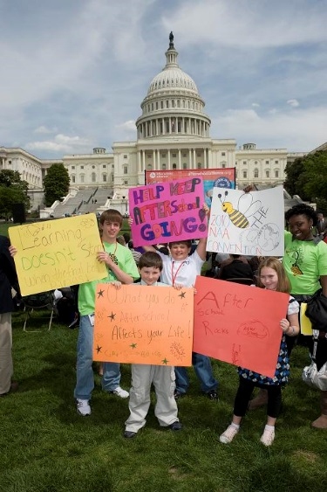
What we will cover
Background: ESEA and federal education policy
Overview of ESSA implementation process
Impact on afterschool and summer learning programs
Questions!

Slide 5
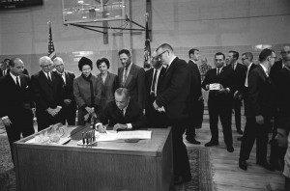
Background: ESEA & education policy

Slide 6
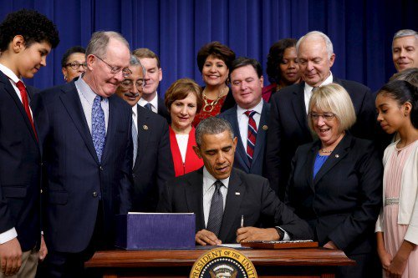
Overview of ESSA
Every Student Succeeds Act

Slide 7
Why does ESSA matter for afterschool?
21st Century Community Learning Centers (21st CCLC)
Science, Technology, Engineering and Math (STEM) Afterschool
Community Schools
More: Literacy, Family Engagement, Youth Promise Plans

Slide 8
21st CCLC
Based largely on bipartisan Afterschool for America’s Children Act (S. 308)
Strengthens hands-on, experiential learning; STEM, CTE; physical activity & nutrition education, financial literacy, environmental literacy
Increases PD/TA support through external organizations
Provides accountability measures that go beyond test scores
Maintains formula grants to states
Allows limited expanded learning programming

Slide 9
STEM Afterschool
Top-level takeaway – more opps for STEM and afterschool but fewer dedicated pots of $ for STEM-specific activities
MSP program eliminated; but new funds for STEM Master Teacher Corps program and $ for teacher PD
Math and science assessment requirements maintained
Engineering and Computer Science added explicitly into definition of STEM

Slide 10
STEM Afterschool
New Title IV program “Student Support and Academic Enrichment Grants” allows LEAs to use $ to support afterschool (STEM).
Details in Sec. 4104 (State Uses of Funds) and Sec 4107 (Activities to Support Well Rounded Educational Activities)

Slide 11
Community Schools
Community Support for School Success
Authorizes at least 10 grants annually for the Full-Service Community Schools [FSCS] program.
Provide assistance to FSCS programs to improve the coordination and integration, accessibility, and effectiveness of services for children and families.
Grants will provide a minimum of $75,000 each year

Slide 12
But wait there is more!
Literacy
Family Engagement
Youth Promise Plans
Title I opportunities

Slide 13
Questions!
FAQ in development
Get more in depth: 4 webinars being planned
?
Notes:
All

Slide 14
Connect with us
Follow Us
Like Us
Read Us
@afterschool4all
/afterschoolalliancedc
Afterschool Snack Blog
www.afterschoolalliance.org
Send your questions to:
epeterson@afterschoolalliance.org
And look for continually updated FAQ.
Notes:
Erik

