Slide 1
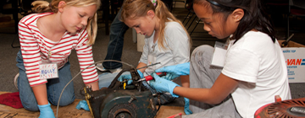
Digging into Research: Gender Equity in STEM
The webinar will begin shortly.
Notes:
Poll questions up.

Slide 2
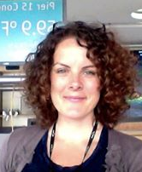
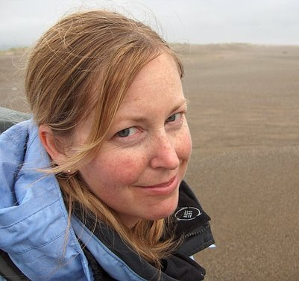
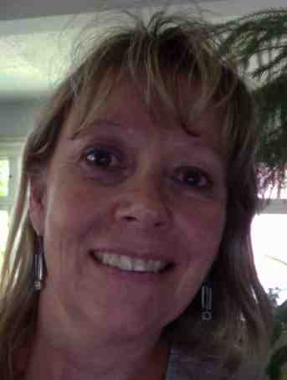
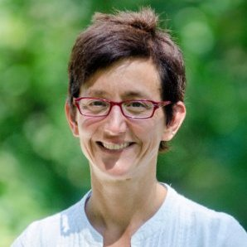
Today’s Speakers
Brenda Britsch
Researcher, National Girls Collaborative
Molly Shea
Researcher, Exploratorium
Jrene Rahm
Professor, Université de Montréal
Melissa Ballard
STEM Manager, Afterschool Alliance
Angie Calabrese Barton
Professor, Michigan State University
Notes:
Brief introductions:
Molly is the Director of the Center for Informal Learning & Schools at the Exploratorium, which has several projects that investigate STEM learning in the out-of-school time space, producing useful resources for STEM educators. Molly’s background is in the learning sciences.
Brenda is the senior research scientist at the National Girls Collaborative, which brings together programs working on girls & STEM, through regional networks, shared resources, and capacity building.
Jrene
Angie

Slide 3
Overview
Background on initiative (5 min)
Gender equity intro (5 min)
Panelist discussion (20 min)
Audience Q & A (10 min)
Audience discussion: Using research in practice (5 min)
Upcoming research & opportunities (5 min)

Slide 4
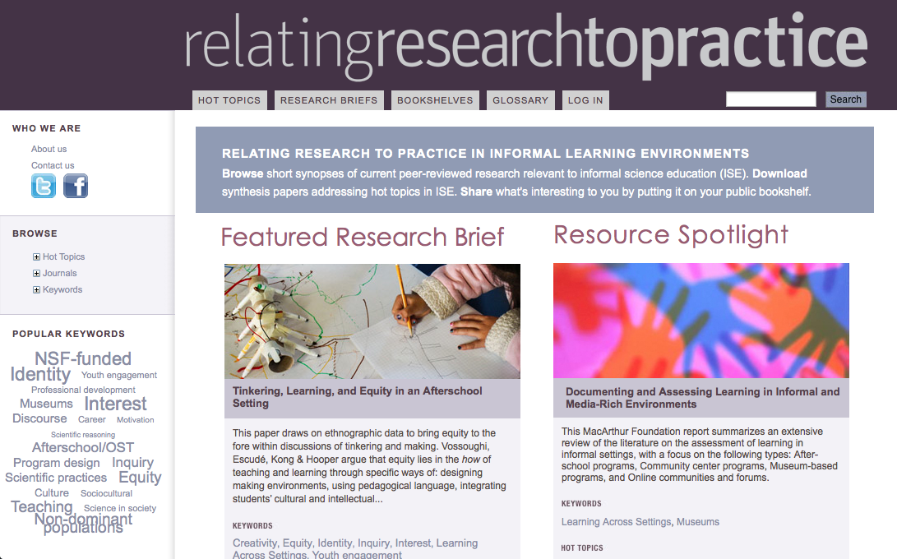
Notes:
Relating Research to Practice is led by the Exploratorium, in partnership with the Afterschool Alliance, the University of Washington and Kings College London.
For the past couple years we have been following science education journals, picking out interesting articles, and producing short research briefs.
Briefs are more than just longer abstracts, we build on the expertise and experience of the brief writer to pull out and highlight what might be most interesting to educators in informal settings. In briefs produced in this past year, we’ve also tried to situate the original paper in broader research trends.
Recently have been looking for ways to expand our audience and reach more practitioners, one by producing the Connected Collections, and two by trying out a virtual discussion.
Molly is one of the co-authors of this CC, and of a couple others, and will tell you more about the collections.

Slide 5
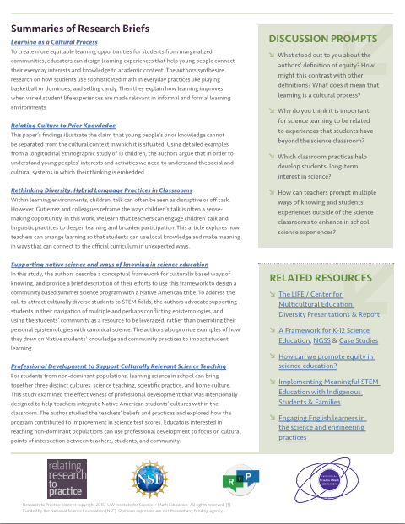
Connected Collections
Include:
An overview and learning goals for a select topic
4-6 short synopses of recent research published in journals
A set of overarching discussion prompts and links to other relevant resources
relatingresearchtopractice.org/hot_topics

Slide 6
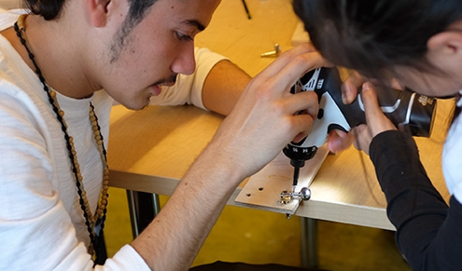
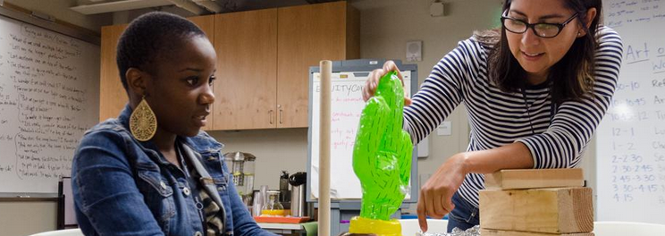
What is Gender Equity?

Slide 7
Panel Discussion
Q1 | How are gender and science identities important aspects of learning to keep in mind when teaching science?

Slide 8
Panel Discussion
Q2 | Why is it important to help girls make connections across home, school, and after-school science to broaden notions of “what counts” as science?

Slide 9
Audience Question
Q3 | Think about your own practice: What barriers have you seen for girls interested in constructing science-linked identities?
Notes:
Panelists can comment on what the audience responds with.

Slide 10
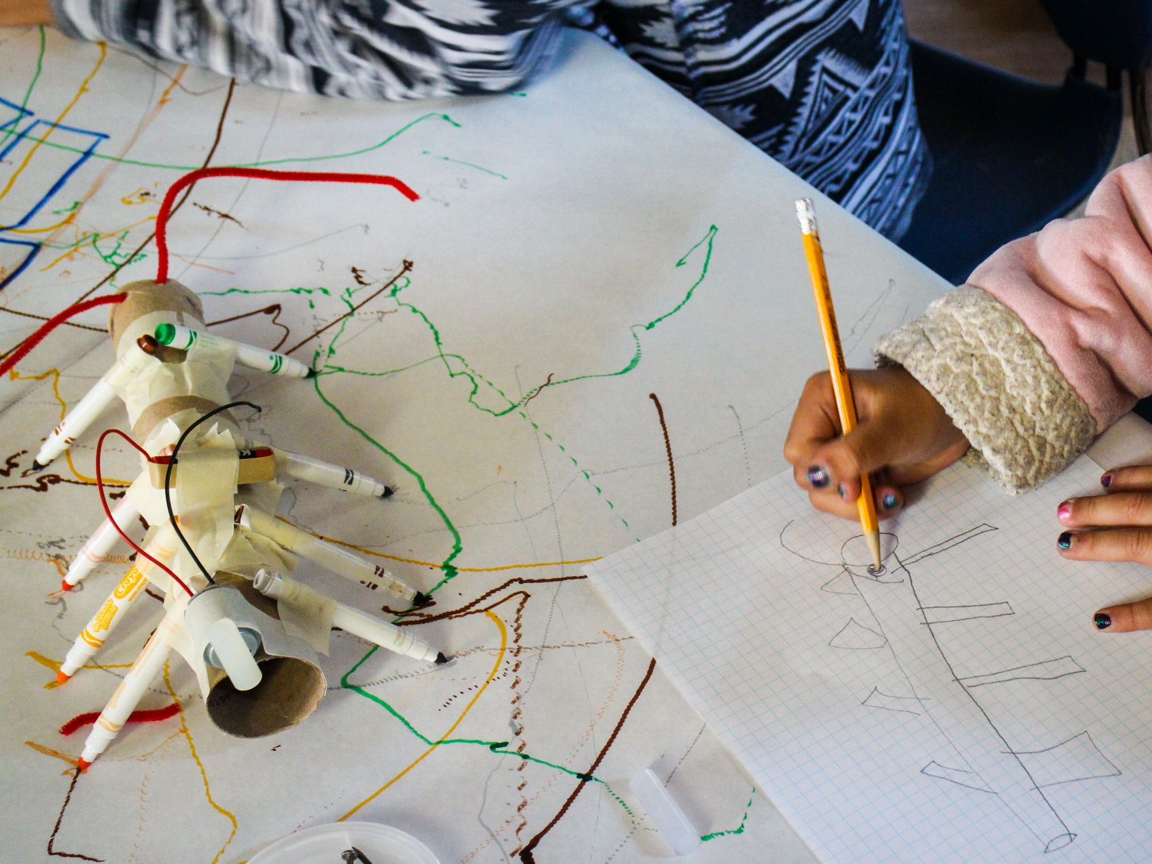
Audience Q & A

Slide 11
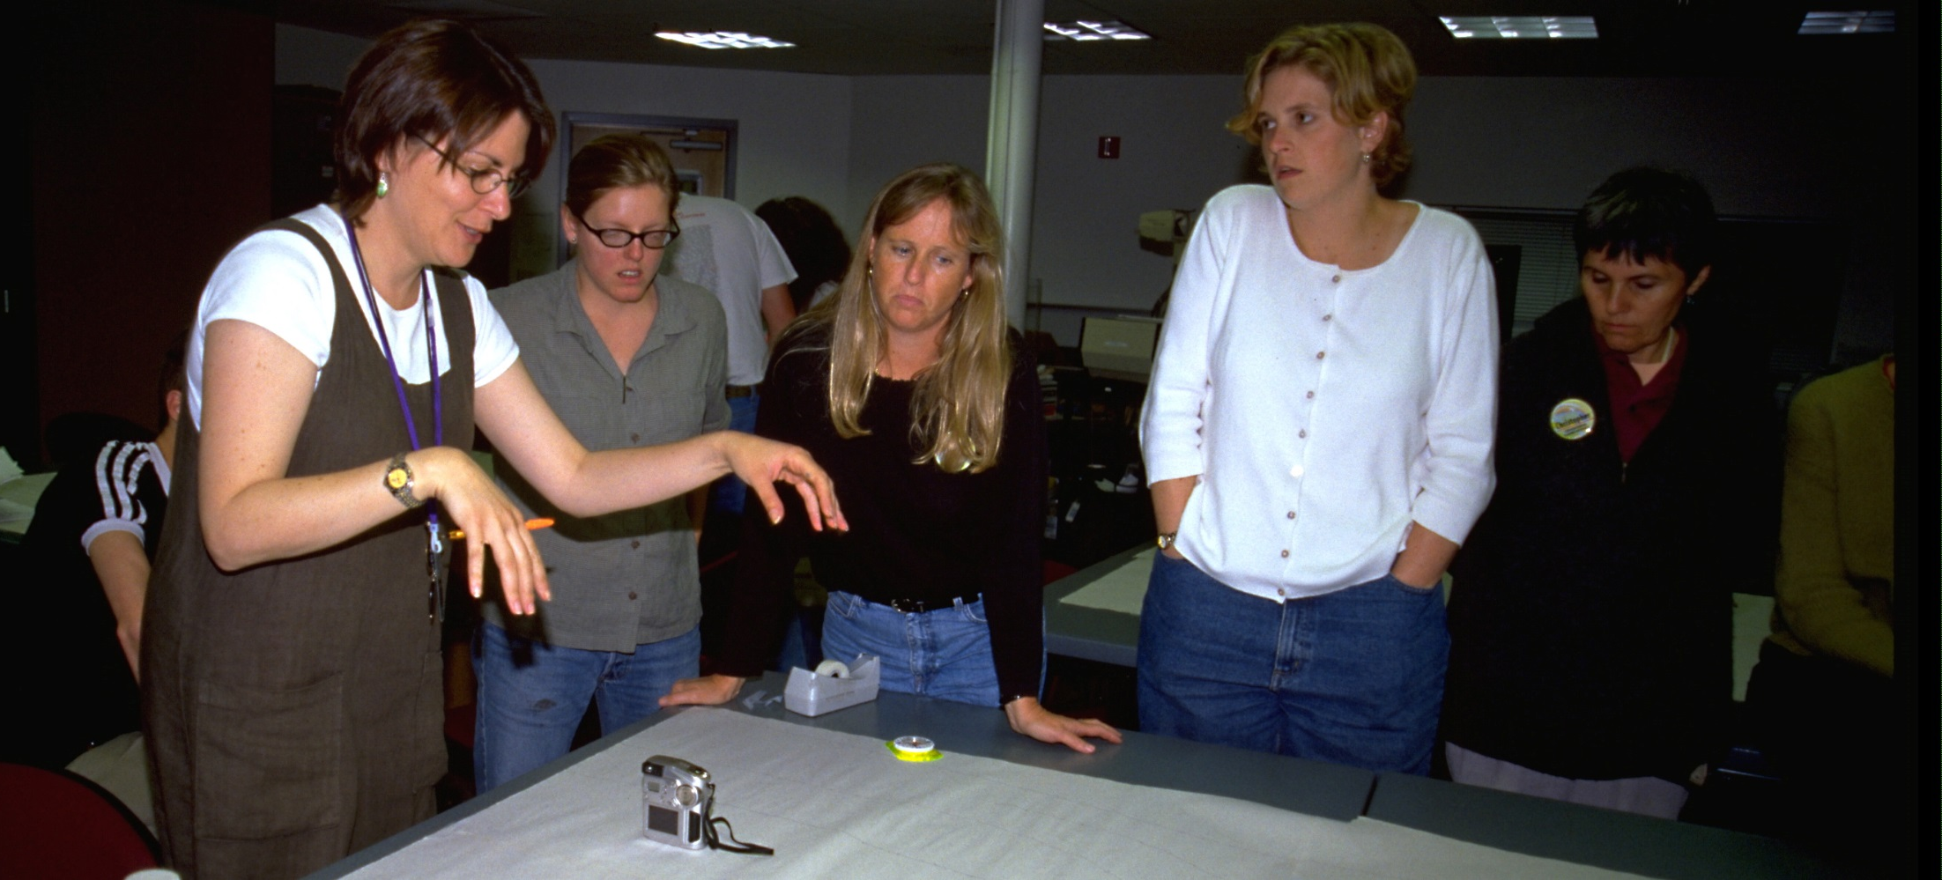
Research in Practice: How might you use a Connected Collection in your practice? Personally? With staff?
Notes:
Ask audience to reflect and type in answers for 2 min.

Slide 12
From last week’s webinar:
Professional development for staff
Building language for training, reporting, grant writing & reflection
Dialogue with staff to improve practice
Communicate to importance of thoughtful pedagogy
Structuring activities & programs
Gaining support for programs
Grant proposals
Articulate value to funders & educational partners
Getting buy-in from principals or administrators
Documenting the research base of out-of-school time learning to support the field as a whole
Notes:
Compare to what people wrote today.

Slide 13
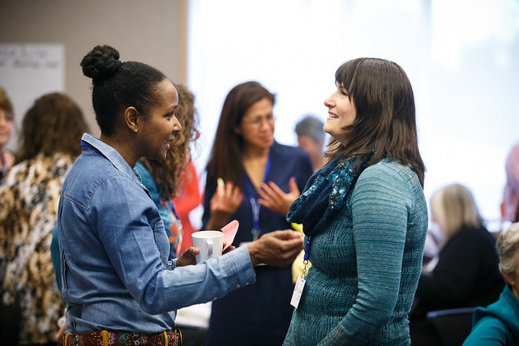
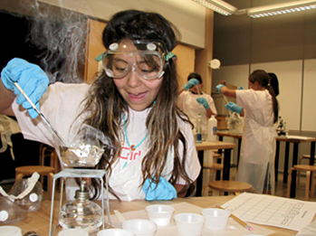
National Girls Collaborative Project
The National Girls Collaborative Project facilitates collaboration, provides professional development, and disseminates research-based resources and strategies to advance gender equity in STEM.
Join your regional collaborative! www.ngcproject.org

Slide 14
Jrene’s current & upcoming research
Youth participation & identity work within equity-driven STEM education
Using a cross-setting approach
Video-making projects in afterschool STEM clubs
How youth articulate science and themselves in science through the process of producing video documentaries
Teacher education in afterschool programs & informal science venues, supported by university-school-community partnerships
Gardening for sustainability / Food activism
Indigenous ways of knowing & learning
Participatory research with Inuit youth and their communities
Notes:
If you know of any interesting research projects, let us know in the chat box!

Slide 15
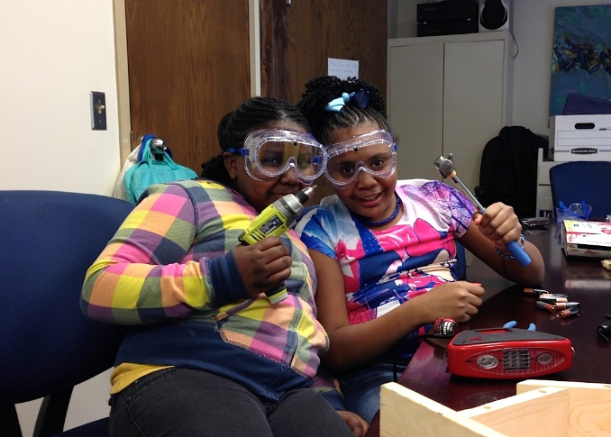
Angela Calabrese Barton Michigan State University With: Edna Tan (UNCG), Bob Geier (MSU),
Scott Calabrese Barton (MSU) Boys & Girls Clubs of Lansing, MI & Greensboro, SC
The Invincibility Lab
invincibility.us
Making 4 Change (NSF): Co-creating equitable maker spaces with youth for learning & identity development in STEM
Focus on African American girls & maker identities
I-Engineering (NSF): Tools for teaching & learning engineering practices: Pathways towards productive identity development in engineering in the middle grades
Focus on youth of color in lower-income communities & learning/identity in engineering
Bridging informal & formal STEM Education
Big Ideas
Learning to recognize & respond to the ways in which youth develop, repurpose tools, reorganize practices, & expand repertoires as they engage in activity in engineering
Learning to challenge cultural/historical narratives of who can & do science, & what it means to become scientific
Science that "matters" -- moving into STEM and/or taking action in one's life and community

Slide 16
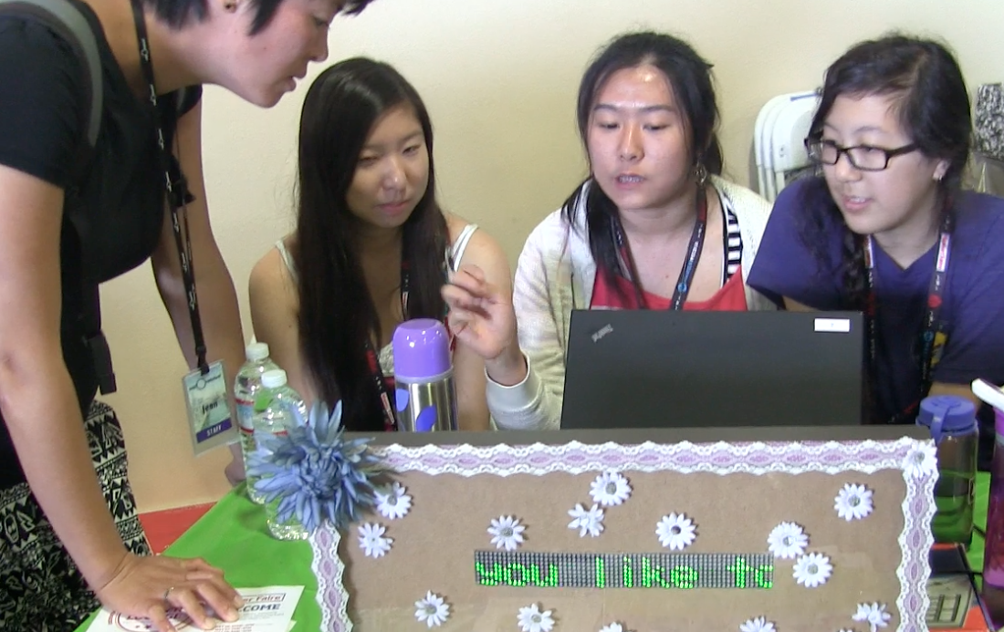
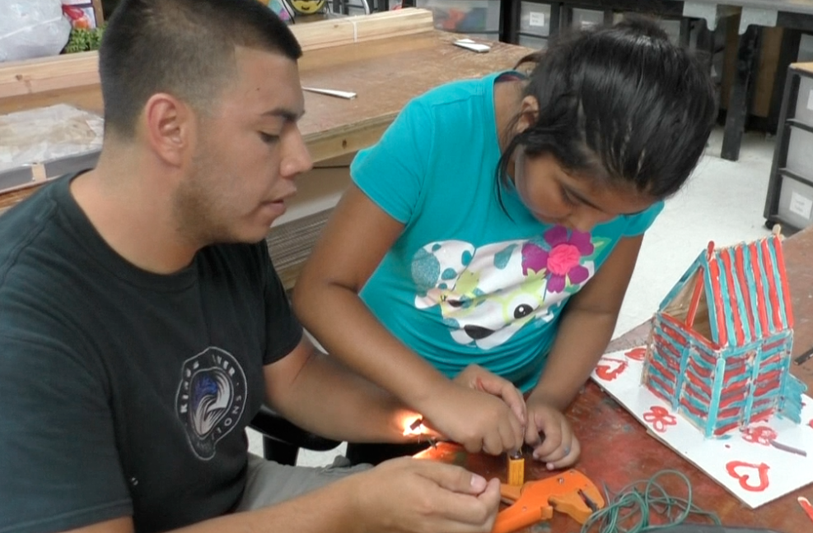
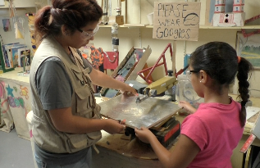
California Tinkering Afterschool Network
What professional learning supports, tools, and routines are needed to sustain equity-oriented STEM-rich tinkering programs for youth in afterschool settings?
NEW tools:
Equity reflection application
Supporting pedagogical practices:
Drafts and iteration
Kids talk and meaning making
Asset-based pedagogy
Value mapping for programs
www.exploratorium.edu/education/california-tinkering-afterschool-network
Notes:
STEM-rich tinkering places scientific concepts and practices into the hands of students through activities that blend low- and high-tech materials (e.g., Arduino microcontrollers, fabric, etc.) while inviting participants to create objects with utilitarian, aesthetic and/or self-expressive dimensions
Equity is not simply access
We consider how tinkering, STEM, and equity-oriented facilitation must fit together within the context of the community and the learning environment.
We believe in the "resourceful and intellectual spontaneity” of facilitators, their understanding of kids, and their abilities to build on new ideas or helpful reminders supported by toolkits.
We know that strong facilitators leverage their understanding of local community to support kids as they make sense of STEM practices across settings.
Our Network identified three focal areas of equity-oriented pedagogy
that support STEM-rich tinkering & NGSS Practices:
1.
Asset-Based Pedagogy: More than a set of facilitation moves;
a theoretical and political stance towards students and their
communities that involves widening our definitions of intelligence
to recognize the diverse resources and knowledge that children
bring into a learning space from all experiences and settings in
their lives (e.g., home, school, peer groups, etc.).
2.
Iterations & Drafts: Designing iterative activities and engaging
learners in ways that feel safe, collaborative, open-ended, and
student-driven so that children build confidence and reframe
dominant notions of "failure."
3.
Student Talk & Meaning-Making: This focal area involves
developing skills to encourage and deepen students' curiosity and
build on their understanding and values about the world as they
develop identities. This is achieved as educators listen to students’
ideas, stories, and questions to build on students’ diverse ways of
making meaning of the world and STEM phenomena

Slide 17
Thank you for attending!
Angie Calabrese Barton
acb@msu.edu
Molly Shea
mshea@exploratorium.edu
Brenda Britsch
bbritsch@ngcproject.org
Melissa Ballard
mjballard@afterschoolalliance.org
Afterschool Snack Blog
NGCP Blog
/RelatingRtP
/ngcproject
/afterschoolalliancedc
@RelatingRtP
@afterschool4all
@ngcproject
Notes:
If you could, kindly answer the poll questions. Our evaluators will greatly appreciate it, and of course it will help inform our next research webinar this upcoming Tuesday.
Recording out next week, will include slides and chat box text.
Join our Gender Equity research webinar next Tuesday June 30, at 2pm with NGCP and other guest researchers.
Heads up our evaluators, they’ll be sending out a longer survey next month.
Contact us with any questions or feedback.

